Slide 1



BAZAAR STORES
TEAM 4

Slide 2



TEAM MEMBERS
SADEEM ABDULAZIZ
ABDULLAH BATARFI
SARAH HAKAMI
FATIMA AL-HAMMAM
LINA AL-HUMAIDI
GHADEER AHMED

Slide 3

SCOPE & METHODOLOGY
UI Testing Overview
Scope: Customer, Manager, Admin UIs
Method: Selenium + Cucumber BDD
Focus: UI + API Validation

Slide 4
REQUIREMENTS & VALIDATION
Product Backlog
Roles:
Customer (Cart & Browse)
Manager (Product CRUD)
Admin (User & Store Management)

Slide 5
DEMONSTRATION SETUP & TRANSITION
Next Phase: Demonstration
Focus: Navigating the Application
Goal: Demonstrating the Features
QA Value: Issues Reported & Solved

Slide 6









TOOLS AND PLATFORMS

Slide 7
TASK DISTRIBUTION
ABDULLAH : ADMIN-STORE MANAGEMENT
SARAH : USER MANAGEMENT
SADEEM – SHOPPING CART MANAGEMENT
LINA – BROWSING PRODUCTS
FATIMA – STORE MANAGER
GHADEER – AUTHENTICATION

Slide 8
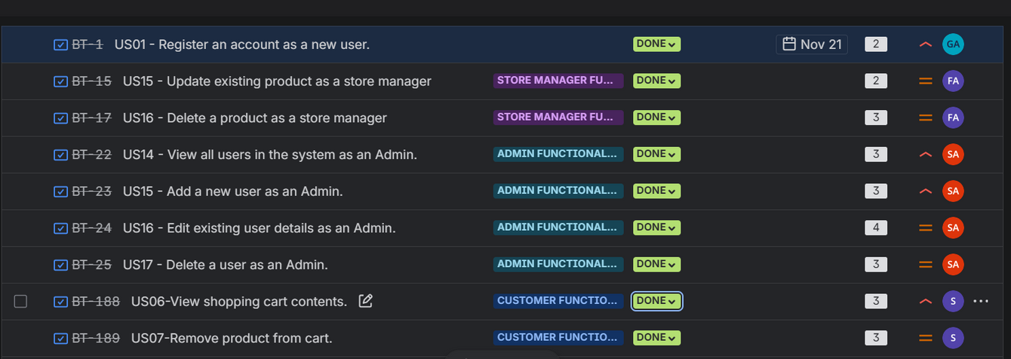
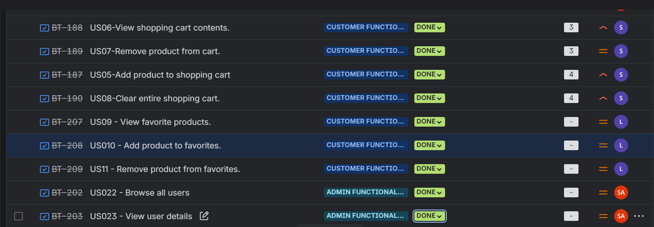
JIRA PRESENTATION BOARD

Slide 9
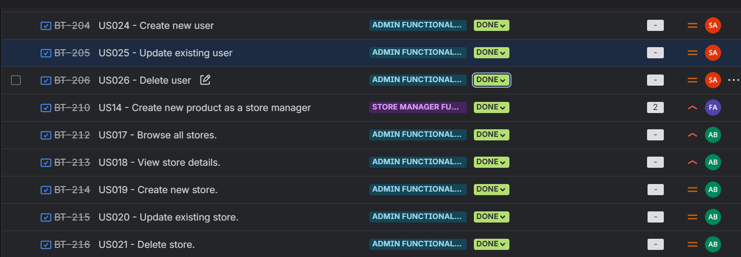
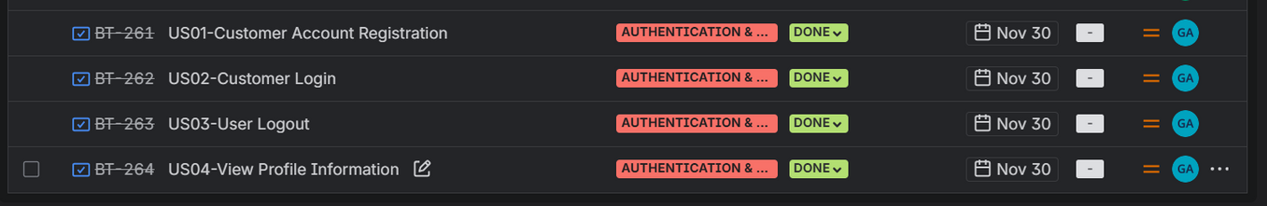
JIRA PRESENTATION BOARD

Slide 10
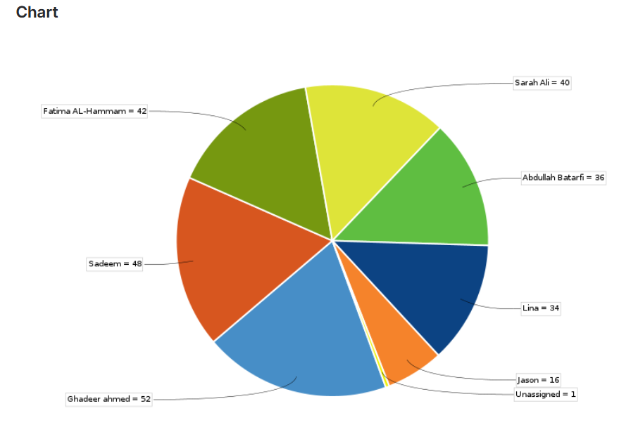
JIRA CHART

Slide 11
UI AUTOMATION WITH
INTELLIJ & JENKINS

Slide 12
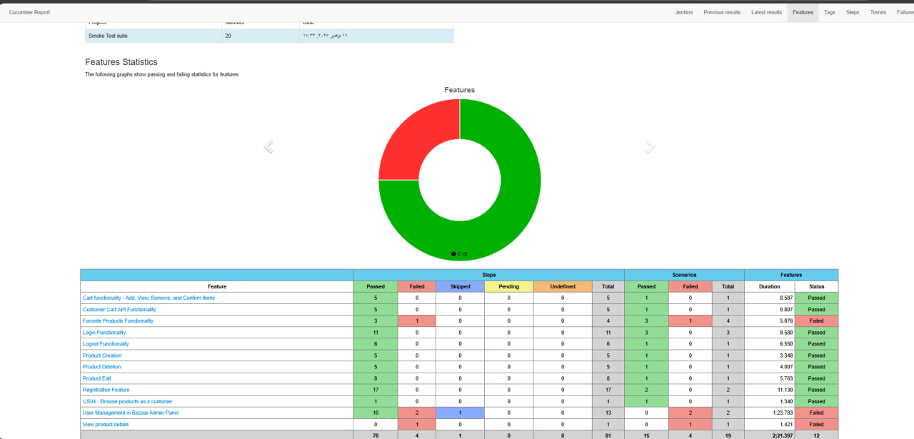
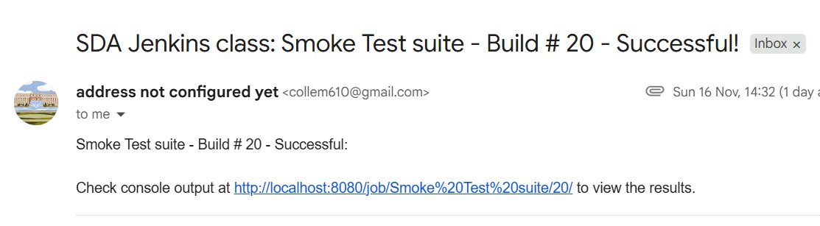
RUN TEST AUTOMATION UI
Smoke Test & Regression Test Suite
Jenkins run with email report

Slide 13
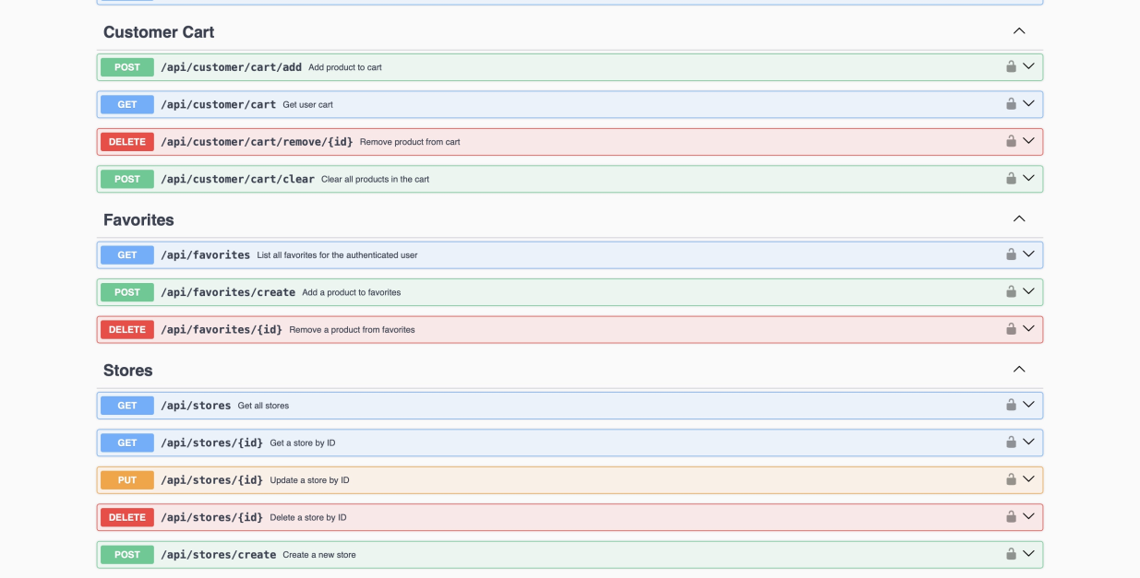
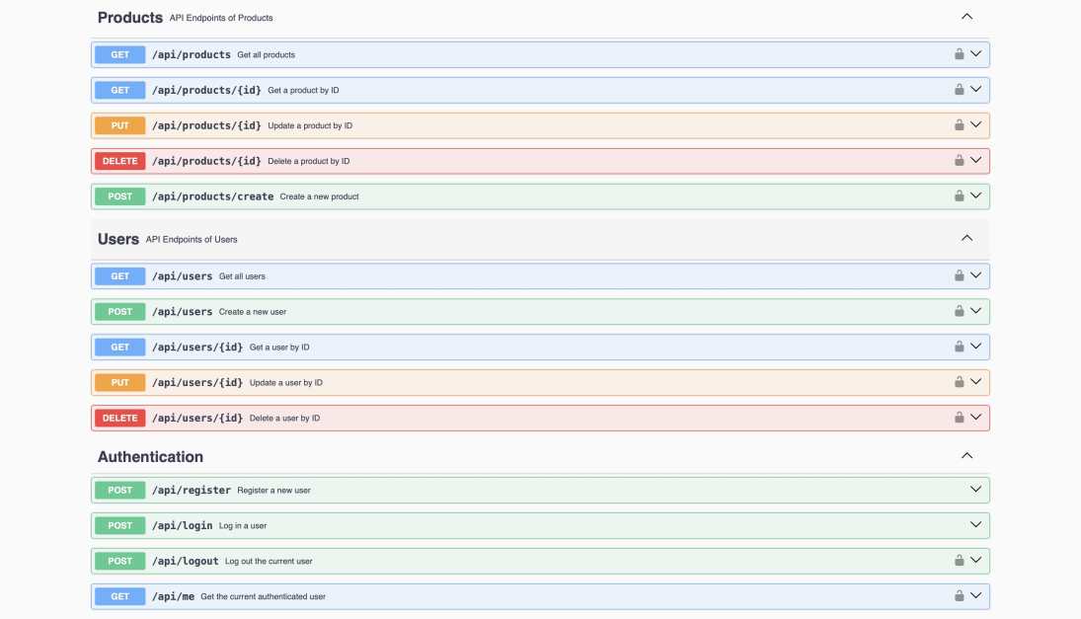
INTRODUCING SWAGGER
An interactive interface to browse all system endpoints
Allows testing API requests directly from Swagger
Displays request body, response, and status codes for each endpoin.

Slide 14
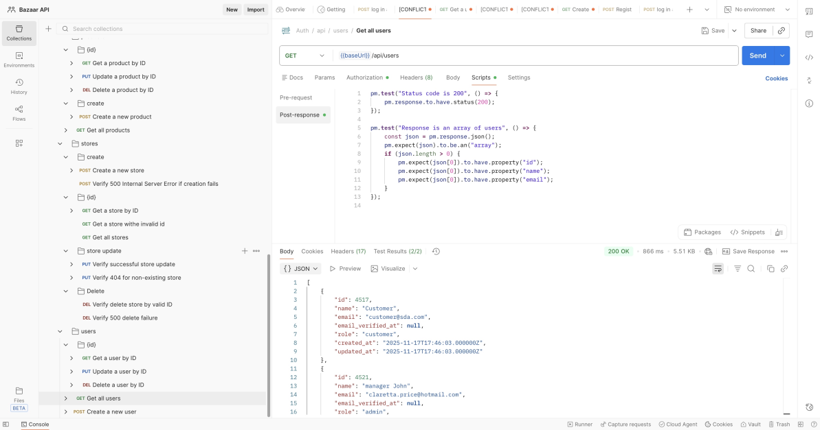
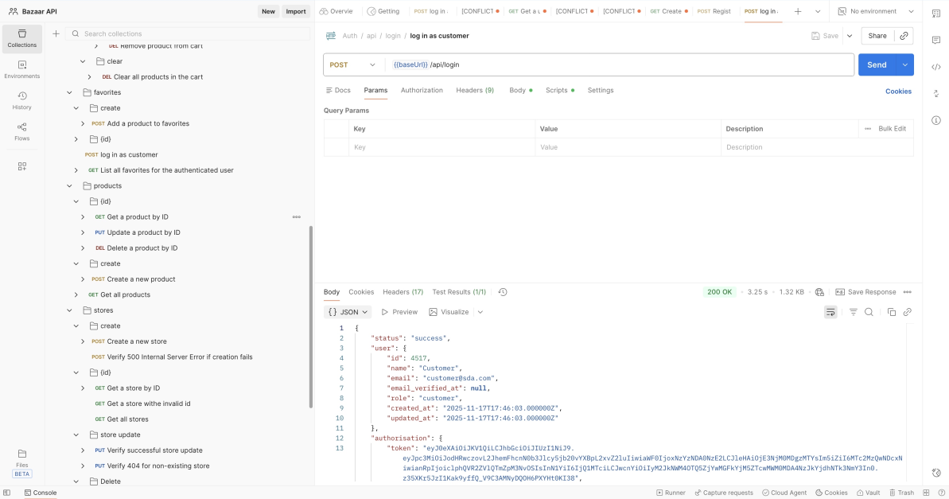
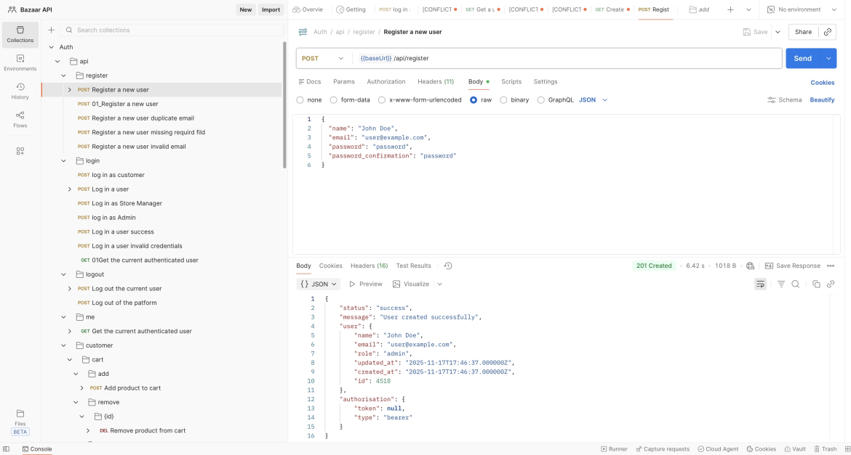
POSTMAN API PRESENTATION
Create a Postman Collection including all system endpoints
Organize tests into folders such as Register – Login – Products – Stores – Users – Favorites – Cart
Add success and failure scenarios to validate the API in all cases

Slide 15
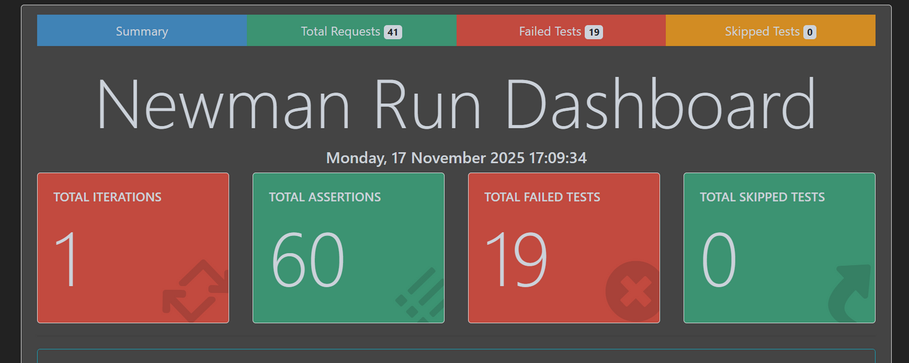
NEWMAN HTML REPORT
Run the Postman Collection via Newman to generate an automatic HTML report.
Execute 60 API requests — showing both successful and failed results.
The report helps easily identify and track errors for each endpoint

Slide 16
AUTOMATION WITH REST ASSURED & TESTNG

Slide 17
GITHUB
GitHub is a platform for hosting code, tracking changes, and enabling teamwork through version control. It helps teams collaborate, review updates, and organize project development efficiently.
We started by reviewing the existing GitHub repository, including the folder structure, branches, and current code layout.
After understanding the initial setup, we demonstrated the improvements we made refining the UI structure, organizing the API endpoints, and making the overall project cleaner, more consistent, and easier to maintain.

Slide 18
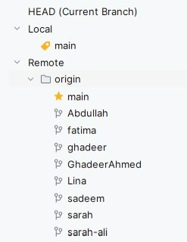
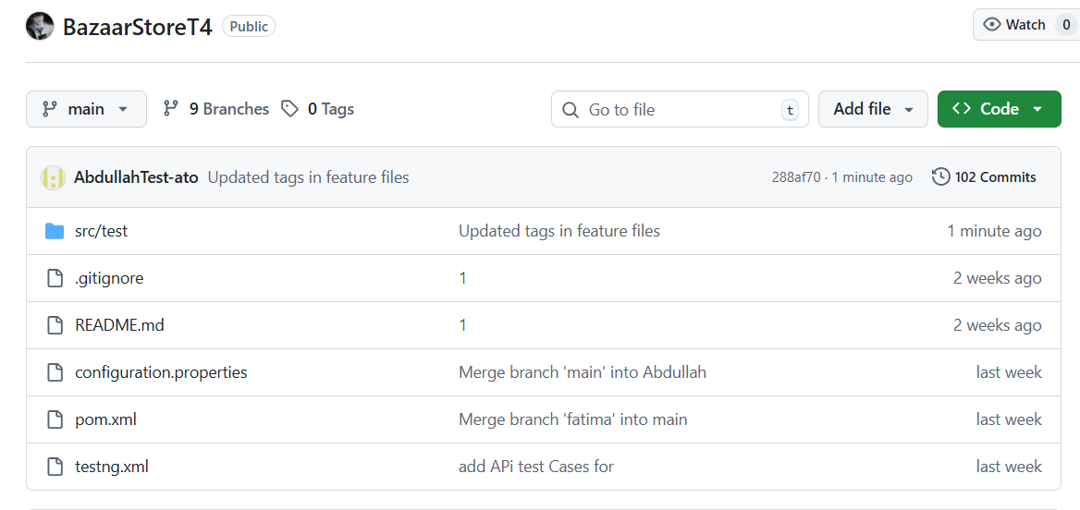
GITHUB REPO & BRANCHES UI

Slide 19
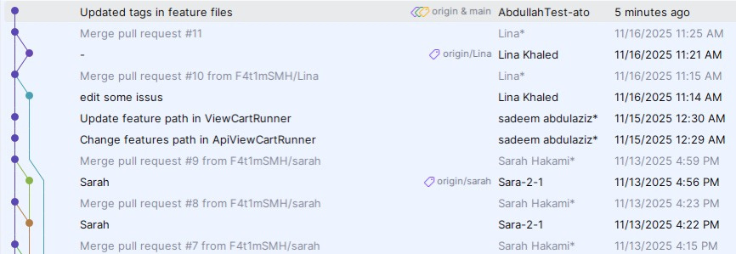
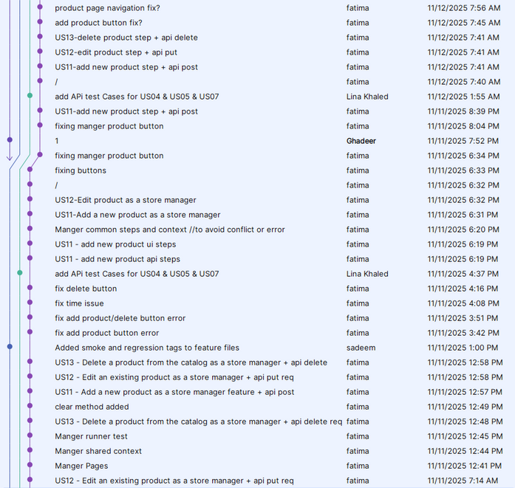
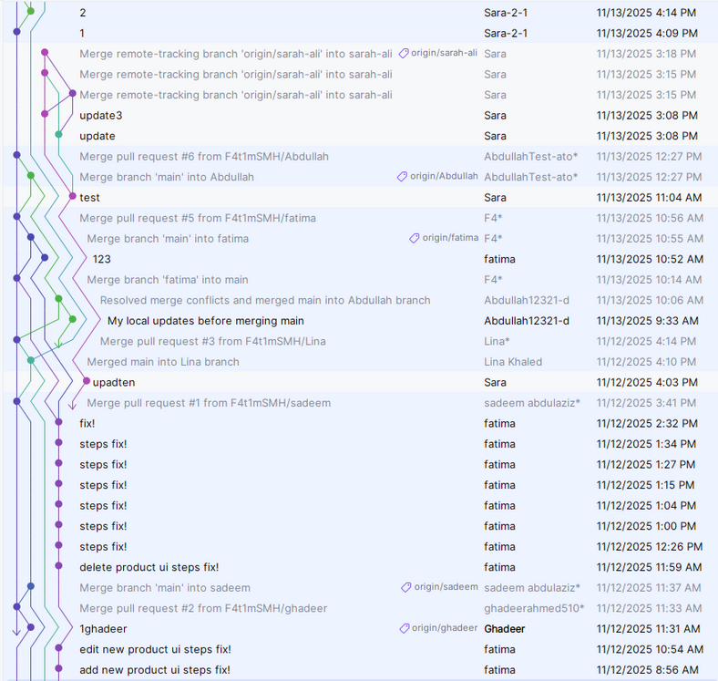
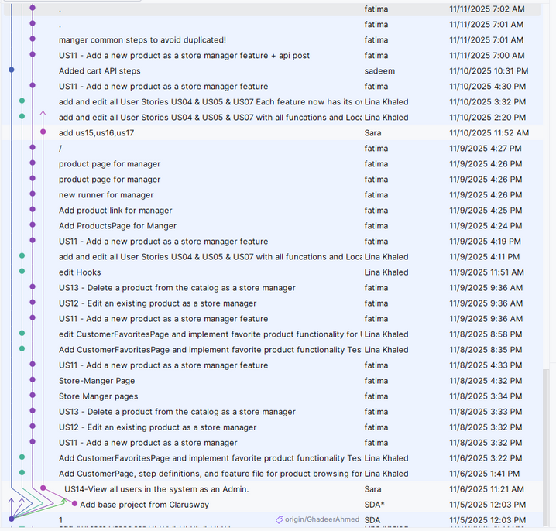
GITHUB REPO & BRANCHES UI

Slide 20
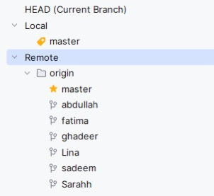
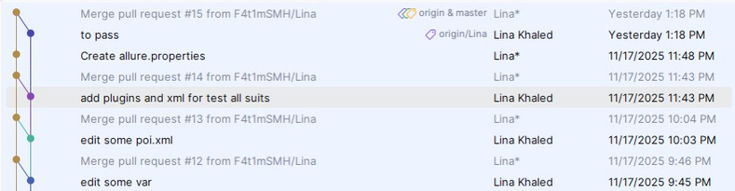
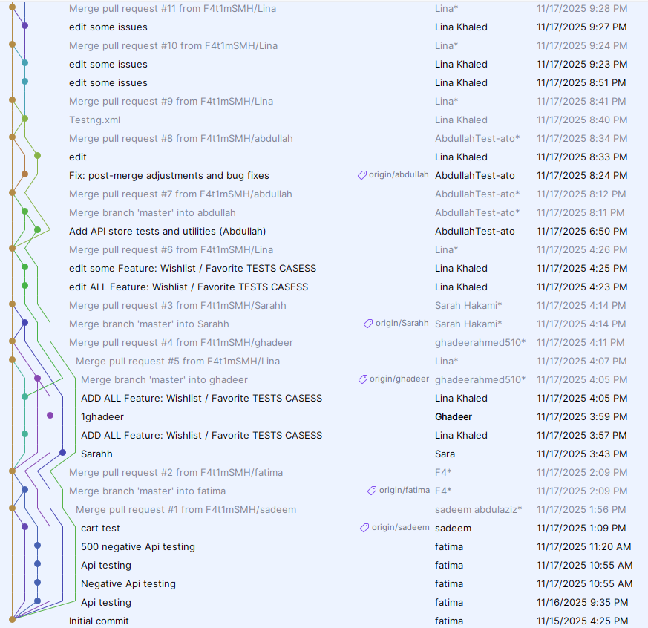
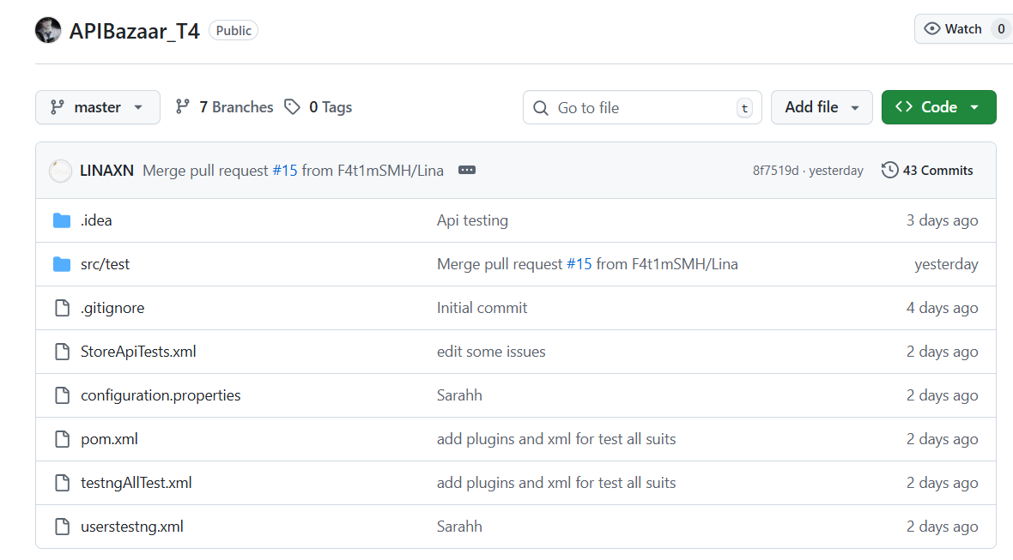
GITHUB REPO & BRANCHES API

Slide 21
THANK YOU

